Slide 1


Love, Friendship, & Social Support
[Professor Name]
[Class and Section Number]
Notes:
Classroom Recommendations: This lecture can be completed in a single class period. If you need to shorten it, you can remove some of the activities. If you want or need to lengthen the lecture, you can add in activities from the module.
Overview: Friendship and love, and more broadly, the relationships that people cultivate in their lives, are some of the most valuable treasures a person can own. This module explores ways in which we try to understand how friendships form, what attracts one person to another, and how love develops. It also explores how the Internet influences how we meet people and develop deep relationships. Finally, this module will examine social support and how this can help many through the hardest times and help make the best times even better. You can start off by asking students what they think these constructs are (What is love? Friendship?) or you could also ask them why they think these constructs are important.
Technical Note:
These slides may contain simple click animation so that you can focus students’ attention on a particular question, a selection of text, or an image and not have them be distracted by reading ahead. You can either preview the sequence of animation by going through the slides in slideshow view, visiting the animations tab, or reviewing the slide notes. In the notes you will see a cue - (Click) – that corresponds to each animation.
You may also find hyperlinks to outside videos at various places in the slides. These hyperlinks are embedded in text and indicated by color and in the notes section.

Slide 2
Today’s Learning Objectives
Understand what attracts us to others
Review research that suggests that friendships are important for our health and well-being
Examine the influence of the Internet on friendship and developing relationships
Understand what happens to our brains when we are in love
Consider the complexity of love
Examine construct + components of social support
Notes:
Purpose:
This slide is to help create structure for the class – reminding students what the “big picture” of todays class is all about.

Slide 3

Warm Up Activity
Discussion:
  Why are relationships important?
  What’s the difference between romantic and platonic love?
  What matters more – the quantity or quality of your friendships?
Notes:
Purpose:
This is an activity that can take place before the students review the content in class. You can use it to see where the students are at and as a talking point throughout the rest of the lecture.
(Click): Why are relationships important?
(Click): What’s the difference between romantic and platonic love?
(Click): What matters more – the quantity or quality of your friendships?
Notes:
Humans have basic needs and one of them is the need to belong; these needs are what makes us human and gives a sense of purpose and identity to our lives.
This module will examine how relationships begin; the impact of technology on relationships; and why coworkers, acquaintances, friends, family, and intimate partners are so important in our lives.

Slide 4
Overview
Introduction
Attraction
Friendship
Love
Social Support
Notes:
Overview slide
Shows all major topics to be covered as well as significant sub-topics (sub topics that have at least 1 slide of their own)
This slide helps students see the “big picture” of your lecture, which makes it easier to make connections between topics.

Slide 5
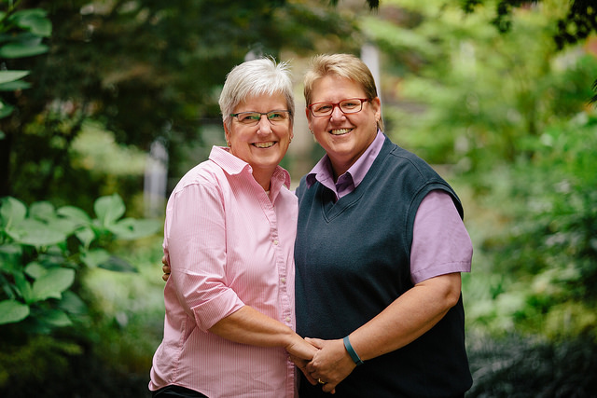
Introduction
The Importance of Relationships
Notes:
Purpose:
This slide is meant to introduce students to the reasons WHY we talk about relationships – what happens when someone lacks support? How does having support influence our health and coping behaviors?
(Click): The importance of relationships:
1) Lack of social relationships is linked to suicide:
Being socially connected is imperative to achieving personal well-being. For example, a person who has no close relationships is likely a person who is at risk for suicide. In other words, suicide tends to be higher among those who become disconnected from society.
2) Can be described as a need/necessity:
Research has demonstrated that we are social creatures and we need others to survive and thrive. Another way of thinking about it is that close relationships are the psychological equivalent of food and water; in other words, these relationships are necessary for survival. Baumeister and Leary (1995) maintain that humans have basic needs and one of them is the need to belong; these needs are what makes us human and give a sense of purpose and identity to our lives.
3) Important to our well-being:
Friendship (namely social support) linked to well-being and can serve as a buffer to stress. That is, it increases happiness and well-being and makes our lives better in general.
Reference:
Baumeister, R. F., & Leary, M. R. (1995). The need to belong: desire for interpersonal attachments as a fundamental human motivation. Psychological Bulletin, 117(3), 497.

Slide 6
Overview
Introduction
Attraction: The Start of Friendship and Love
Friendship
Love
Social Support
Notes:
Mid-lecture Overview

Slide 7
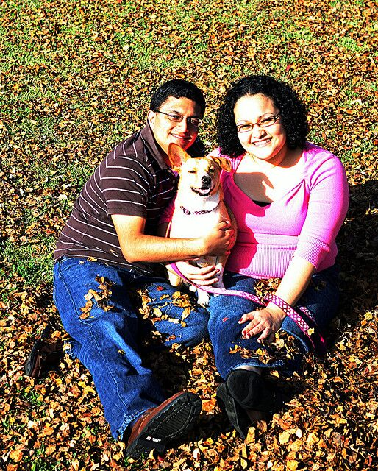
Attraction: The Start of
Friendship and Love
Proximity
  Functional Distance
  If I Didn’t Have You Video
Familiarity
  Mere Exposure Effect
  How I Met Your Mother Video
Notes:
Purpose:
This slide is meant to help students understand the factors associated with what draws us to other people (both romantically and platonically).
(Click): Proximity
(Click): Functional Distance
Physical nearness has been found to be a significant factor in the development of relationships. Proximity is not just about geographic distance, but rather functional distance, or the frequency with which we cross paths with others.
(Click): Link to video of “If I didn’t have you” by Tim Minchin
This video is a humorous song that taps into the concept of proximity. The comedian starts out by talking about the chances of meeting your “soulmate” at the same high school/college/etc. He then starts singing a parody of the typical love song, except the premise is that “If I didn’t have you, I’d probably be able to find someone else.” If you like to keep a fun and light-hearted mood to your class, then this would be a nice video choice. If you don’t have time or the tone of the video does not match your class, you can scrap this without losing a lot of content.
Link: https://www.youtube.com/watch?v=LAzodf69rfk&feature=youtu.be
(Click): Familiarity
People are more attracted to that which is familiar. We also tend to feel safe with familiar people, as it is likely we know what to expect from them.
(Click): Mere exposure effect
Just being around someone or being repeatedly exposed to them increases the likelihood that we will be attracted to them. This refers to the idea that people develop a preference for things merely because they are familiar with them. For example, at the beginning of the semester, you might not really notice the person sitting next to you in class, but after a few weeks or toward the end of the semester, you begin to think they are pretty cute ☺
(Click): Link to video from popular American TV show, How I Met Your Mother (a popular sitcom about five young adults in New York and their relationships/friendships; link starts at 30 seconds)
After talking about the formal psychological concepts behind familiarity, it might be fun to show how this psychological concept has been demonstrated in popular media. You could also START your discussion on familiarity with this clip and ask students if they think there is any merit to the “Mermaid Theory” as Barney describes it.
The clip: According to Barney, men will eventually feel sexually attracted to women simply as a result of spending time with them, even if they initially don’t find these women attractive at all. Even the least physically attractive people ("manatees") will eventually look like mermaids. Barney predicts that Marshall will one day feel attracted to his female secretary simply because she works in his office, and Marshall becomes worried he would someday feel attracted to Robin (a close female friend) simply because they hang out a lot.
Link: https://youtu.be/f1A5_gxL5_g?t=30

Slide 8

Activity: The Matching Game
I need 10-20 volunteers
Directions
  I am assigning you a number
  WITHOUT looking, put the sticky note on your forehead
  Try to find the BEST partner (highest number)
Notes:
Purpose:
The goal of this activity is to do an actual demonstration of similarity before you talk about it formally. Watch the YouTube video before doing this in class so that you can see what it should look like (https://www.youtube.com/watch?v=gxoWUL0eqg4).
(Click): I need 10-20 volunteers
(Click): Directions
(Click): I am assigning you a number
(Click): WITHOUT looking, put the sticky note on your forehead
(Click): Try and find the BEST partner (highest number)
Time:
5-15 minutes depending on how you decide to run the activity
Materials:
Post-it notes for each group (they need to have a sticky side so that they can be stuck on each person). Sticky notes should be prepared before class starts. First, watch this video. It is a clear demonstration of what you will be doing in class: https://www.youtube.com/watch?v=gxoWUL0eqg4
Directions:
Students are randomly assigned a numerical value, which they place on their forehead so others can see it but the student cannot. The goal is to pair off with another student with as high a value as possible. The simulation, called the Pairing Game, illustrates how matching on similarity can occur, even in the absence of knowledge of one's own value and merely by seeking the highest value possible in a partner.
First, watch this video. It is a clear demonstration of what you will be doing in class: https://www.youtube.com/watch?v=gxoWUL0eqg4
Before class, create the sticky notes in pairs, with a rating corresponding to the number of pairs. For example, if you are going to have 10 volunteers, you will have 5 pairs, so you should label your sticky notes from 1-5 (and create two for each number).
Select 10-20 volunteers (mostly dependent on class size and how much time you have; use fewer volunteers if you have a small class or are short on time). Needs to be an even number.
Once your volunteers are selected, randomly assign them one of the numbers. Have them place the sticky note on their forehead or back – the important thing is that other students can see their number, but they cannot see it.
Give them the following directions: I am assigning you a number. WITHOUT LOOKING AT IT, place the number on your forehead. Your goal is to find the best mate possible: the higher the number, the better the mate. When you have found someone with a high number, hold out your hand (as if you are shaking it). If they accept your hand, both of you move to the side. If they do not accept your hand, you have to find someone else to pair up with. Again, your goal is the get the BEST mate possible (the highest number).
Once all students have paired up, you can look at how they matched up (don’t expect exact matches). A fun class activity and discussion!
Give them the following directions:
I am assigning you a number. WITHOUT LOOKING AT IT, place the number on your forehead. Your goal is to find the best mate possible: the higher the number, the better the mate. When you have found someone with a high number, hold out your hand (as if you are shaking it). If they accept your hand, both of you move to the side. If they do not accept your hand, you have to find someone else to pair up with. Again, your goal is the get the BEST mate possible (the highest number).
Considerations:
Class size: The size of your class might influence how you complete this activity. For example, in a large class, you could probably get 20 volunteers (resulting in 10 pairs), but in a smaller class you might only use 8 volunteers (resulting in 4 pairs).
Time: if you have more time, you could have students get into groups of about 10 students (MUST be an even number) and complete the activity. If you have less time, you could get your volunteers and bring them up to the front of the class for the demonstration (less time spent organizing groups, materials, etc.)

Slide 9
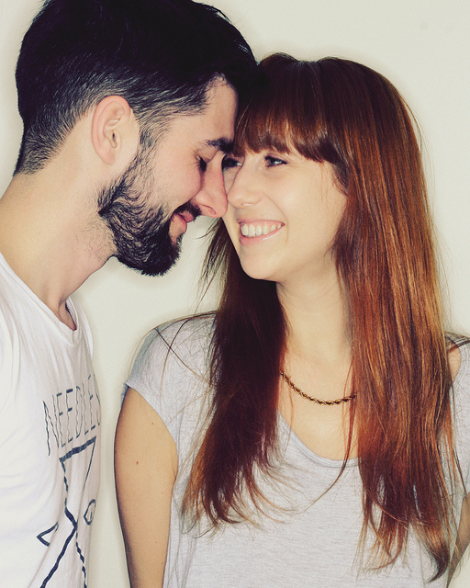
Attraction
Similarity
  Science of Sex Appeal-The Dating and Mating Pool Video
  Reciprocity
How have these principles shaped your relationships?
Notes:
Purpose:
As with the previous slide, this slide is meant to help students understand the factors associated with what draws us to other people (both romantically and platonically).
(Click): Similarity:
While many make the argument that opposites attract, research has found that is generally not true; similarity is key. When it comes to marriage, research has found that couples tend to be very similar, particularly when it comes to age, social class, race, education, physical attractiveness, values, and attitudes. This phenomenon is known as the matching hypothesis.
(Click): Link to video on the activity they just completed https://www.youtube.com/watch?v=gxoWUL0eqg4
If you don’t have the time, you might consider cutting this video. However, it might be helpful for them to see very clearly the matching hypothesis.
(Click): Reciprocity
This principle is based on the notion that we are more likely to like someone if they feel the same way toward us.
(Click): Discussion Question: How have these principles shaped your relationships (both platonic and romantic)?
Here, you can turn the discussion over to the class. More than likely, they will have already begun to informally thinking about this question. You could guide the discussion by starting off with platonic relationships, as students may feel more comfortable talking about those (as opposed to romantic relationships). Then, depending on how your class reacts, you could either have them follow up with discussion of romantic relationships of their own, OR you could have them apply the principles to famous or fictional couples (e.g., Romeo & Juliet; Bonnie & Clyde; Jim and Pam from the Office; Amy and Sheldon from The Big Bang Theory). The importance is the couple per se, but rather to get them thinking about how those couples display the principles behind attraction, love, and friendship.

Slide 10
Overview
Introduction
Attraction
Friendship
Love
Social Support
Notes:
Mid-lecture Overview
Close friendships can protect our mental and physical health when times get tough.

Slide 11
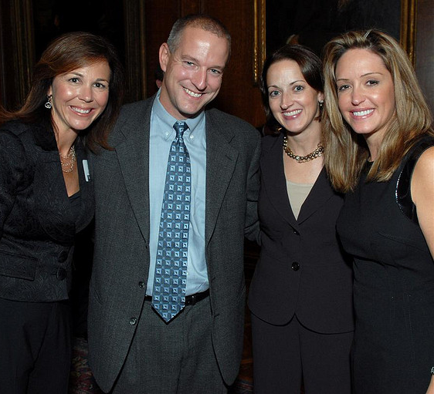
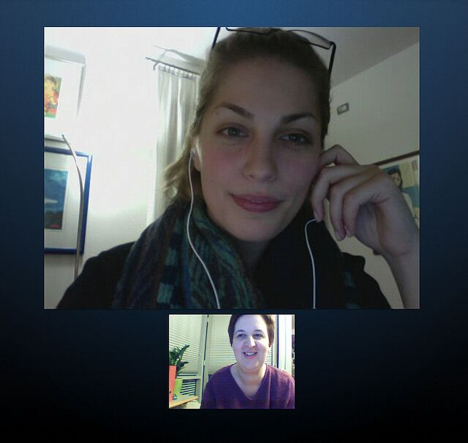
Friendship
Workplace Friendships
Internet Friendships
Notes:
Purpose:
The purpose of this slide is to help students understand how close friendships can protect our mental and physical health when times get tough.
(Click): Workplace Friendships
Friendships often take root in the workplace, due to the fact that people are spending as much, or more, time at work than they are with their family and friends. People who worked in an environment where friendships could develop and be maintained were more likely to report higher levels of job satisfaction, job involvement, and organizational commitment, and they were less likely to leave that job.
(Click): Internet Friendships
Virtual relationships are often as intimate as in-person relationships. This can be especially true for those individuals who are more socially anxious and lonely.

Slide 12
Overview
Introduction
Attraction
Friendship
Love
Social Support
Notes:
Mid-lecture Overview

Slide 13
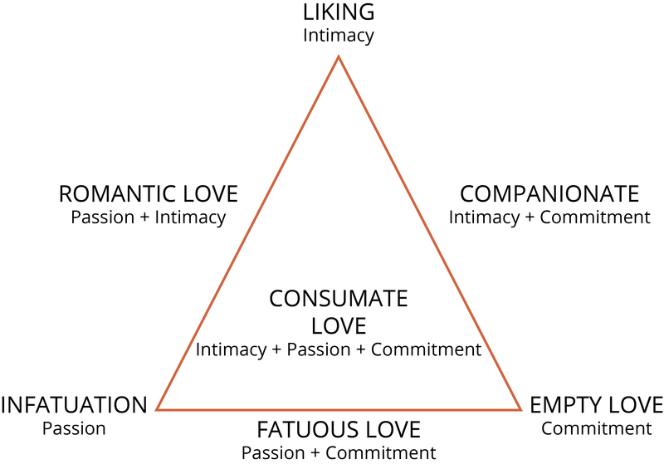
Love
Types of Love
  Intimacy
  Passion
  Commitment
Love & Biology
Notes:
Purpose:
The purpose of this slide is to help students understand the multifaceted nature of love.
(Click): Types of love
All types of love are comprised of three distinct areas: intimacy, passion, and commitment.
(Click): Intimacy
Intimacy includes caring, closeness, and emotional support.
(Click): Passion
The passion component of love is comprised of physiological and emotional arousal; these can include physical attraction, emotional responses that promote physiological changes, and sexual arousal
(Click): Commitment
Lastly, commitment refers to the cognitive process and decision to commit to love another person and the willingness to work to keep that love over the course of your life.
(Click): Picture of Triangular Theory of Love
This picture is Figure 1 from the book
(Click): Love & Biology
Anthropologist Helen Fisher explained that she scanned the brains (using fMRI) of people who had just fallen in love and observed that their brain chemistry was “going crazy,” similar to the brain of an addict on a drug high. Specifically, serotonin production increased by as much as 40% in newly in-love individuals.
Those newly in love tended to show obsessive-compulsive tendencies. Conversely, when a person experiences a breakup, the brain processes it in a similar way to quitting a heroin habit. Thus, those who believe that breakups are physically painful are correct!
Another interesting point is that long-term love and sexual desire activate different areas of the brain. More specifically, sexual needs activate the part of the brain that is particularly sensitive to innately pleasurable things such as food, sex, and drugs, whereas love requires conditioning—it is more like a habit. When sexual needs are rewarded consistently, then love can develop. In other words, love grows out of positive rewards, expectancies, and habit.

Slide 14

Love
Love and the Internet
Do you think there is a stigma attached to online relationships?
How might that impact a couple’s relationship?
Notes:
Purpose:
In today’s increasingly technological world (the internet, self-driving cars, etc.), it’s no surprise that technology has changed the way people perceive relationships. Thus, the goal of this slide is to expose alternate ways to think of relationships (long-distance relationships, online dating, etc.).
(Click): Love & The Internet:
Social networking sites, and the Internet generally, perform three important tasks. Specifically, sites provide individuals with access to a database of other individuals who are interested in meeting someone. Dating sites generally reduce issues of proximity, as individuals do not have to be close in proximity to meet. Also, they provide a medium in which individuals can communicate with others. However, online relationships leave room for deception; thus, people have to be cautious.
Discussion Questions:
(Click): Do you think there is stigma attached to online relationships?
(Click): How might that impact a couple’s relationship (intimacy, passion, commitment)?
You can use this as an opportunity to encourage discussion with your students – allowing them to apply concepts from previous sections (factors of attraction, types of love) to the internet. It will be interesting to hear what your students have to say!

Slide 15
Overview
Introduction
Attraction
Friendship
Love
Social Support
Notes:
Mid-lecture Overview

Slide 16


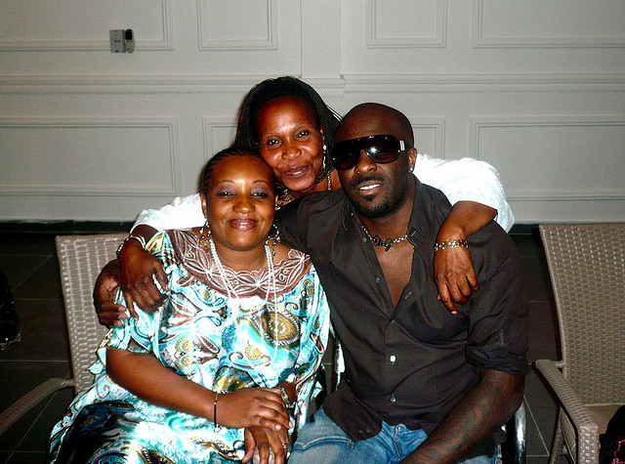
Social Support
Perceived
Received
Quantity or Quality?
Notes:
Purpose:
When bad things happen, it is important for people to know that others care about them and can help them out. Unsurprisingly, research has found that this is a common thread across cultures and over time; in other words, social support is the active ingredient that makes our relationships particularly beneficial. But what is social support? One way of thinking about social support is that it consists of three discrete conceptual components. Thus, the purpose of this slide is to help students understand the importance and types of social support.
(Click): Perceived
When things go wrong, you know you have friends and/or family members that are there to help you. Perceived support has also been linked to well-being and can serve as a buffer to stress. That is, perceived social support increases happiness and well-being and makes our lives better in general.
(Click): Received
The actual receipt of support or helping behaviors from others. Unlike perceived support, the benefits of received support have been beset with mixed findings. Research has indicated that regardless of the support-provider’s intentions, the support may not be considered as helpful to the person receiving the support if it is unwanted.
(Click): Quantity or Quality?
We have a cognitive limit with regard to how many people we can maintain social relationships with. The general consensus is about 150—we can only “really” know (maintain contact and relate to) about 150 people. However, the research shows that both quantity and quality matter.
Images: First image is of perceived social support one might receive from an online community, for instance; second is of a direct, in-person received social support, and third is of a group of people to convey quality of support vs. quantity of support.

Slide 17
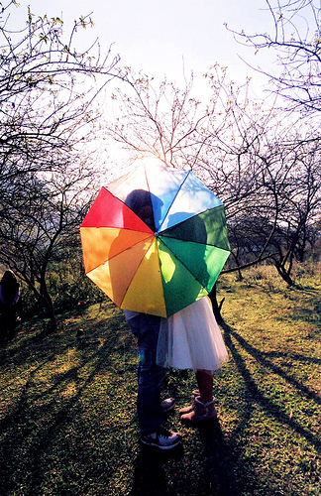
Activity: Predict Your Spouse
Based on the content from class, answer these questions:
  Where are you most likely to meet your significant other?
  What will he/she most likely look like?
  What are some of his/her characteristics?
Notes:
Info: Throughout the lecture, you have been talking about different aspects of developing relationships. By now, the students have a wealth of information to draw upon to predict what their future spouse might be like (e.g., race, age, SES (socio-economic status), religion, attractiveness, etc.). This activity is designed to have them apply that information in a more concrete and personal way.
(Click): Based on the content from class, answer the following questions:
(Click): Where are you most likely to meet your significant other?
(Click): What will he/she most likely look like?
(Click): What are some of his/her characteristics (religion, age, race, values, SES, etc.)?
Time: 5-10 minutes depending on depth of explanation.
Materials: Pens and paper for students
Directions:
You can do this as a class discussion or as a small activity (individual activity is suggested, as students may desire more privacy for their answers). The students are to apply what they have learned about attraction in order to predict what their future spouse will be like.

Slide 18

Wrap Up Discussion
What is the difference between romantic and platonic love?
How has the internet changed what we know about relationships?
How have the principles from this module shaped your relationships?
Notes:
You can end by class by asking students discussion questions that get them thinking/reflecting on the content. Here are a few examples:
What is the difference between romantic and platonic love?
This discussion question is both an explicit and implicit knowledge check (a good question to start out with as it is a pretty psychologically-safe question). You can continue the discussion by either asking for or providing examples of different kinds of relationships and whether or not they typify romantic or platonic love.
How has the internet changed what we know about relationships?
This is a fun question because the current generation of college students are much more familiar with using technology relative to relationships (e.g., using eHarmony or ok cupid for dating; apps like Tinder for sexual relationships, etc.). This question will probably elicit an interesting response from your class!
How have the principles from this module shaped your relationships (both platonic and romantic)?
This is a much more personal question (you could have them do a one-minute paper on this question if you want to keep answers more private). However, this gives the students the opportunity to reflect on their own life and apply the content in a meaningful way. Just make sure that as students answer the questions, they are applying the information (not just talking about their relationships, which they love to do!).

Slide 19

CAT: One-Minute Paper
  What was the most important thing you learned during this class?
  What important question remains unanswered?
Notes:
Classroom Assessment Technique (CAT): One-Minute Paper
If you are presenting the information on one class day, you might end the material about here. End your class time with a one-minute paper.
The Minute Paper tests how students are gaining knowledge, or not. The instructor ends class by asking students to write a brief response to the following questions: “What was the most important thing you learned during this class?” and “What important question remains unanswered?”
Have students briefly answer these questions in writing and turn them in. After class, assess students’ responses. At the beginning of the next class, go over any misunderstandings or relevant questions.
If you do not conclude with this Classroom Assessment Technique (CAT), it would helpful to use another CAT. It could be in the form of a:
Muddy point
One-minute paper
Background knowledge
What’s the Principle?
Defining features Matrix:
For more information on CATs click here: http://cft.vanderbilt.edu/guides-sub-pages/cats/

Slide 20
Photo Attribution
Slide 1 | Photo Credit: Friends on the Sunset Páris Neto https://www.flickr.com/photos/parisneto/6083187411 https://creativecommons.org/licenses/by-nc-sa/2.0/
Slide 3 | Photo Credit: Untitled Lina Hayes https://www.flickr.com/photos/44946121@N07/4585889992/ https://creativecommons.org/licenses/by-nc/2.0/
Slide 5 | Photo Credit: JD10-13byAJR_1B7A3980 Alicia J. Rose https://www.flickr.com/photos/aliciajrose/13453437414 https://creativecommons.org/licenses/by-sa/2.0/
Slide 7 | Photo Credit: IMG_3786 William Heinrich https://www.flickr.com/photos/37205687@N07/4212116626/ https://creativecommons.org/licenses/by-nc-sa/2.0/
Slide 8 | Photo Credit: Students eager to contribute to the debate, raise their hands to speak UK Parliament https://www.flickr.com/photos/uk_parliament/8120181493/ https://creativecommons.org/licenses/by-nc/2.0/
Slide 9 | Photo Credit: lindsay and neil malloreigh https://www.flickr.com/photos/71475737@N00/6870730248/ https://creativecommons.org/licenses/by-nc/2.0/
Slide 11 | Photo Credit: Jeri with friends Xan Pearson and Rudy and Caryn Riemer freddthompson https://www.flickr.com/photos/9313013@N04/1490416987 https://creativecommons.org/licenses/by-sa/2.0/ Photo Credit: skype chat with Leah 2011-03-07 Annette Schwindt https://www.flickr.com/photos/annetteschwindt/5507820902 https://creativecommons.org/licenses/by-nc-sa/2.0/
Slide 14 | Photo Credit: Online romance Don Hankins https://www.flickr.com/photos/23905174@N00/2061329074 https://creativecommons.org/licenses/by/2.0/
Slide 16 | Photo Credit: Friends with Mobile Phones Garry Knight https://www.flickr.com/photos/garryknight/7003178857 https://creativecommons.org/licenses/by/2.0/ Photo Credit: Kinshasa, RDC. 0408 kaysha https://www.flickr.com/photos/26487906@N00/2555123757/ https://creativecommons.org/licenses/by-nc-nd/2.0/ Photo Credit: Close Group Shot Patrick Slaven https://www.flickr.com/photos/20872388@N06/5659715471 https://creativecommons.org/licenses/by-nc/2.0/
Notes:
Photo Attribution Slide

Slide 21
Photo Attribution
Slide 17 | Photo Credit: i'll take you away, turn this place into our private getaway https://www.flickr.com/photos/linhngan/4221211723 https://creativecommons.org/licenses/by/2.0/
Slide 18 | Photo Credit: Questions1 Grisel D´An https://www.flickr.com/photos/128454566@N06/15893429463 https://creativecommons.org/licenses/by-nc/2.0/
Slide 19 | Photo Credit: Illustrated silhouette of a black cat nehtaeh79 http://www.freestockphotos.biz/stockphoto/16624 http://creativecommons.org/publicdomain/zero/1.0/
Notes:
Photo Attribution Slide

